Slide 1
CAP476:
Data Communication and Networking
Unit-I
Network Basics

Slide 2
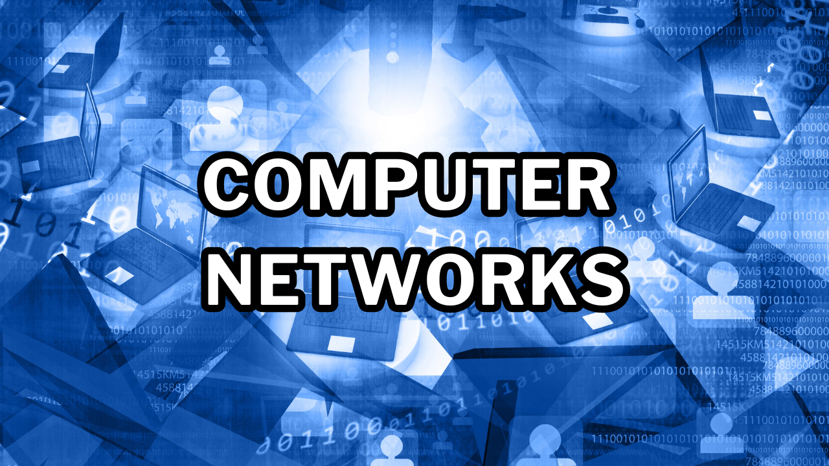
Computer Networks

Slide 3
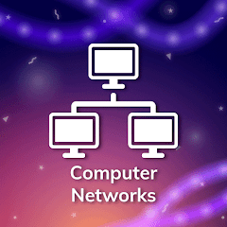
Definition
Devices connected for communication
Share data, resources, information
Use cables or wireless links
Rely on communication protocols
Enable collaboration, efficiency

Slide 4
Data Communication Overview
Computer network: Interconnected devices
Shares resources, information, data
Requires channels for communication
Data: Move sender to receiver
Aim: Efficient, reliable transfer

Slide 5
Communication Effectiveness
Delivery: Correct destination only
Accuracy: No transmission errors
Timeliness: On-time data delivery
Real-time for video/audio
Vital for communication quality

Slide 6
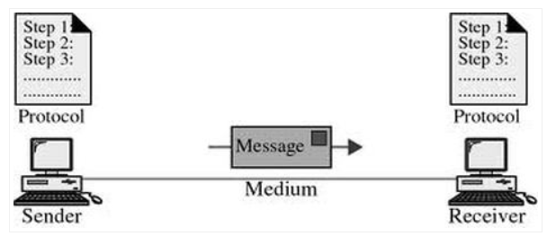
Components of Data Communication System

Slide 7
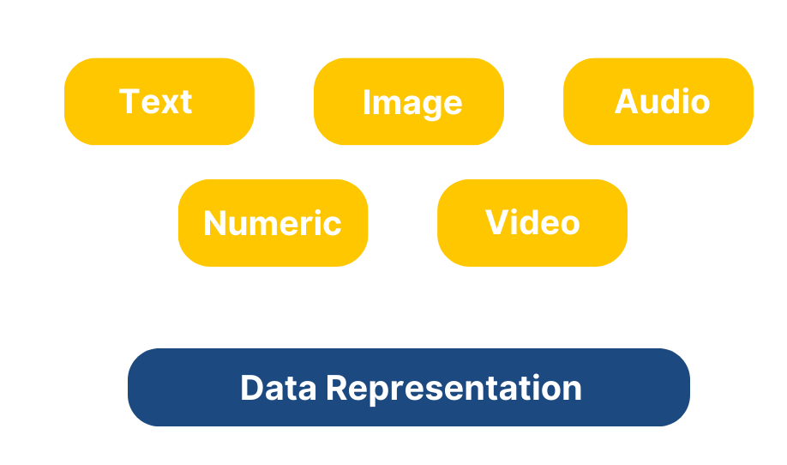
Data Representation Types

Slide 8
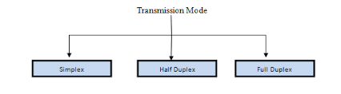
Transmission Modes

Slide 9
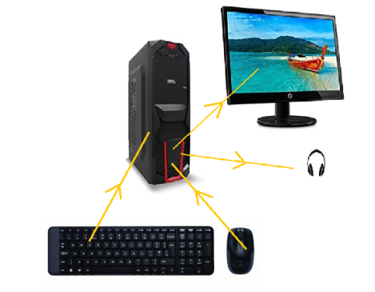
Transmission Modes
Simplex: One-way data only
for example, from your computer to the printer or from the mouse to your computer.

Slide 10
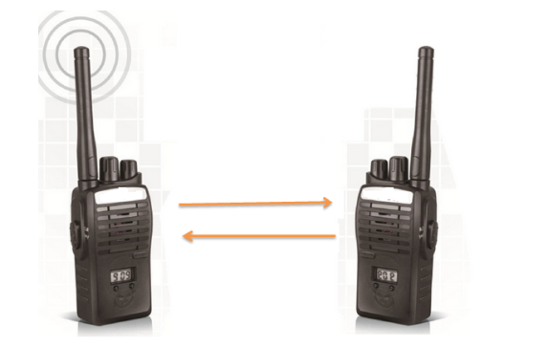
Transmission Modes
Half-duplex: Two-way, not simultaneous
for example walkie talkie

Slide 11
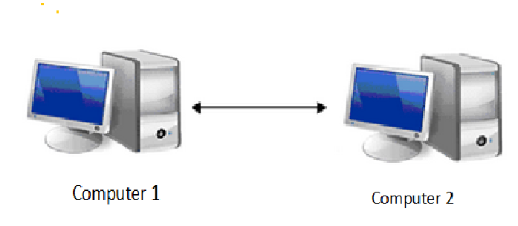
Transmission Modes
Full-duplex: Two-way, simultaneous transmission
For example communication between two interconnected computers, your mobile phones

Slide 12
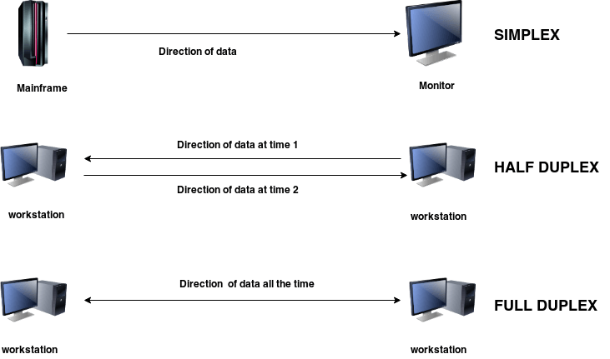

Slide 13


